Slide 1
R
Covariance, ANOVA

Slide 2
the mean value of the product of the deviations of two variates from their respective means.
Differs from their means( average)
Covariance is a measure of how much two random variables vary together. It’s similar to variance, but where variance tells you how a single variable varies, covariance tells you how two variables vary together.

Slide 3
The Covariance Formula
The formula is:
Cov(X,Y) = Σ E((X-μ)E(Y-ν)) / n-1 where:
X is a random variable
E(X) = μ is the expected value (the mean) of the random variable X and
E(Y) = ν is the expected value (the mean) of the random variable Y
n = the number of items in the data set

Slide 4
R code
cov(mtcars$wt, mtcars$mpg)
-5.116685
Negative ( Inverse ) direction
cov(mtcars$wt, mtcars$mpg, method=c("pearson"))

Slide 5
ANOVA – R code
Analysis of Variance
> modelAnova <- aov(mtcars$mpg~mtcars$wt)
> print(modelAnova)
Call:
aov(formula = mtcars$mpg ~ mtcars$wt)
Terms:
mtcars$wt Residuals
Sum of Squares 847.7252 278.3219
Deg. of Freedom 1 30
Residual standard error: 3.045882
Estimated effects may be unbalanced
>

Slide 6
Oneway - Anova
> modelAnova1w <- oneway.test(mtcars$mpg~mtcars$wt)
Error in oneway.test(mtcars$mpg ~ mtcars$wt) : not enough observations
> modelAnova1w <- oneway.test(mtcars$mpg~mtcars$cyl)
> print(modelAnova1w)
One-way analysis of means (not assuming equal variances)
data: mtcars$mpg and mtcars$cyl
F = 31.624, num df = 2.000, denom df = 18.032, p-value = 1.271e-06
> F Value

Slide 7
> model.1 = lm (mpg ~ wt + cyl + wt:cyl, data = mtcars)
> library(car)
Loading required package: carData
> Anova(model.1, type="II")
Anova Table (Type II tests)
Response: mpg
Sum Sq Df F value Pr(>F)
wt 117.162 1 20.8983 8.943e-05 ***
cyl 87.150 1 15.5450 0.0004899 ***
wt:cyl 34.196 1 6.0995 0.0198824 *
Residuals 156.976 28
---
Signif. codes: 0 ‘***’ 0.001 ‘**’ 0.01 ‘*’ 0.05 ‘.’ 0.1 ‘ ’ 1
>

Slide 8
summary
> summary(model.1)
Call:
lm(formula = mpg ~ wt + cyl + wt:cyl, data = mtcars)
Residuals:
Min 1Q Median 3Q Max
-4.2288 -1.3495 -0.5042 1.4647 5.2344
Coefficients:
Estimate Std. Error t value Pr(>|t|)
(Intercept) 54.3068 6.1275 8.863 1.29e-09 ***
wt -8.6556 2.3201 -3.731 0.000861 ***
cyl -3.8032 1.0050 -3.784 0.000747 ***
wt:cyl 0.8084 0.3273 2.470 0.019882 *
---
Signif. codes: 0 ‘***’ 0.001 ‘**’ 0.01 ‘*’ 0.05 ‘.’ 0.1 ‘ ’ 1
Residual standard error: 2.368 on 28 degrees of freedom
Multiple R-squared: 0.8606, Adjusted R-squared: 0.8457
F-statistic: 57.62 on 3 and 28 DF, p-value: 4.231e-12
>

Slide 9
plot
plot(x = mtcars$mpg,
y = mtcars$wt,
col = mtcars$cyl,
pch = 16,
xlab = "MPG",
ylab = "WT")

Slide 10
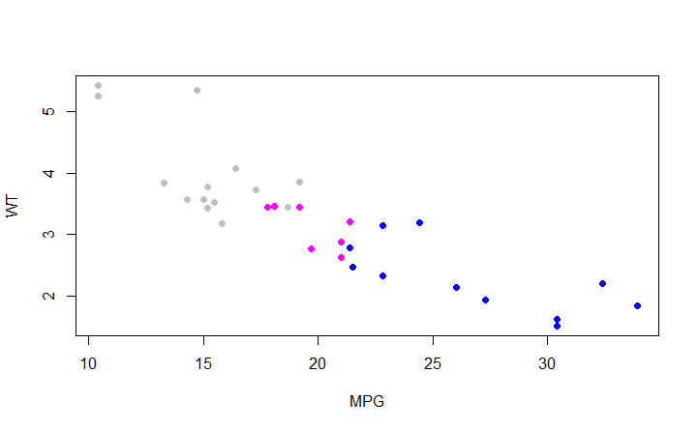
Plot mpg v wt v cyl

Slide 11
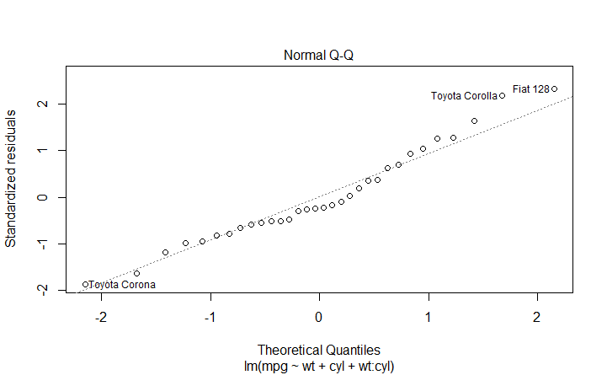
plot(model.1,2)

Slide 12
covariance
Sum of Squares
Residual standard error:
F = 31.624,
num df = 2.000,
denom df = 18.032, p-value = 1.271e-06

Slide 13

The F-test is computed by dividing the explained variance between groups (e.g., gender difference) by the unexplained variance within the groups.
Between groups and within Groups

Slide 14
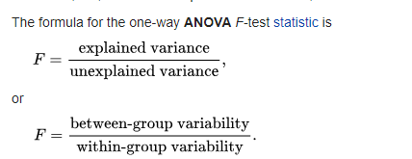

Slide 15
ANALYSIS OF COVARIANCE (ANCOVA)
1. Variance explained by the independent variable (also called between groups variance)
2. Unexplained variance (also called within group variance)
We study the effect of the value of "am" on the regression between "mpg" and "hp". It is done by using the aov() function followed by the anova() function to compare the multiple regressions.

Slide 16
> result1 <- aov(mpg~hp*am,data = mtcars)
>
> result2 <- aov(mpg~hp+am,data = mtcars)
> print(anova(result1,result2))
Analysis of Variance Table
Model 1: mpg ~ hp * am
Model 2: mpg ~ hp + am
Res.Df RSS Df Sum of Sq F Pr(>F)
1 28 245.43
2 29 245.44 -1 -0.0052515 6e-04 0.9806
>

Slide 17
P = 0.9806
As the p-value is greater than 0.05 we conclude that the interaction between horse power and transmission type is not significant. So the mileage per gallon will depend in a similar manner on the horse power of the car in both auto and manual transmission mode.

